Slide 1
An Efficient Algorithm For Heart Attack Detection Using Fuzzy Classification And Alert Using IoT
ISR (Independent Study Research)
Kriti Gupta
A2372014001
3C-B.Tech 6CSE-9BX

Slide 2
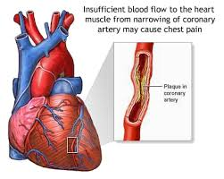
What is heart attack and its causes

Slide 3
Factors causing heart attack
Heart Beat rates
S.No. | Factors
1. | Heart Rate
2. | Total Cholesterol
3. | HDL (High Density Lipids)
4. | LDL (Low Density Lipids)
5. | Triglycerides
6. | Homocysteine
7. | CRP (C-Reactive Protein)
8. | Lipoprotein a
9. | BP (systolic)
10. | BP (diastolic)
11. | Blood Sugar (fasting)
12. | Blood Sugar (Post prandial)

Slide 4
Values of factors
FACTORS | NORMAL LEVEL | BORDERLINE | HIGH RISK
Heart Rate | 60-80 beats per minute | 40-60 bpm & 80-100 bpm | below 40 & above 100 bpm
Total Cholesterol | less than 200 mg/dL | 200-239 mg/dL | 240mg/dL and above
HDL (High Density Lipids) | 60 mg/dL and above | 40-59 mg/dL | less than 40 mg/dL
LDL (Low Density Lipids) | less than 129 mg/dL | 130-189 mg/dL | 190 mg/dL and above
Triglycerides | less than 150 mg/dL | 150-499 mg/dL | 500 mg/dL and above
Homocysteine | 15-30 µmol/L | 30-100 µmol/L | 100 µmol/L and above
CRP (C-Reactive Protein) | less than 1mg/L | 1-3 mg/L | more than 3 mg/L
Lipoprotein a | less than 30mg/dL | NA | 30 mg/dL and above
BP (systolic) | less than 120 mm Hg | 120-139 mm Hg | 140 mm Hg and above
BP (diastolic) | less than 80 mm Hg | 80-89 mm Hg | 90 mm Hg and above
Blood Sugar (fasting) | less than 100 mg/dL | NA | 100 mg/dL and above
Blood Sugar (Post prandial) | less than 140 mg/dL | NA | 140 mg/dL and above

Slide 5
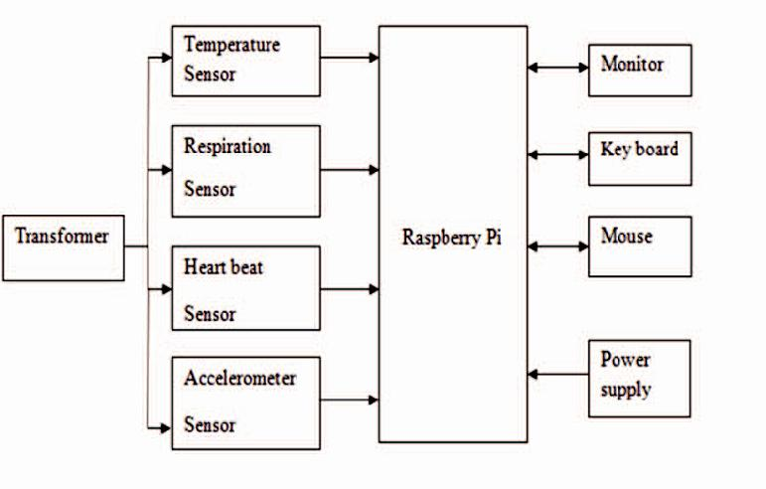
Existing model

Slide 6
Proposed Algorithm
Step 1: Start
Step 2: Input patient data
Step 3: Apply fuzzy c-means clustering
Step 4: Is prone?
if false goto step 2 else goto step 5
Step 5: Send Alert to Registered Sim
Step 6: End

Slide 7
Results
PARAMETER | VALUE
True Positive | 58
True Negative | 24
False Positive | 1
False Negative | 17
Sensitivity | 0.77
Specificity | 0.96
Accuracy | 82%

Slide 8
conclusion
This paper presents an automated mathematical model for detecting a heart attack
The proposed algorithm uses fuzzy c-means clustering for prediction of heart attack in human beings.
The accuracy of the result is 82% which is quite competent as compared to present day techniques.
With the help of IoT the patient and the registered user will be informed in time and save their life from getting an unexpected heart attack.

Slide 9
Thank you

